Slide 1


Search Engine
B Tharun Kumar IN1240349
R K Madhuri IN1240351
Unique Team ID: T211173

Slide 2

Introduction to the Search Engine
The objective of this project is to design a cutting-edge search algorithm that effectively retrieves relevant subtitles corresponding to user inputs.
By utilizing Machine learning (ML) and Natural Language Processing (NLP)Techniques , this algorithm will enhance the accuracy and relevance of search results.
A search engine is a software system that allows users to search for information on the World Wide Web.
Search Engines can be used to find pages, images, videos, business addresses, and other kinds of information. They find this information and rank the pages they feel are relevant according to complex algorithms that are tweaked and improved regularly.

Slide 3
Project Roadmap
Data Sampling
Data Pre processing
Document Chunking
Data Extraction
Text Vectorization(Embeddings)
Results
Storing embeddings in chroma DB
User Query
Semantic Search

Slide 4
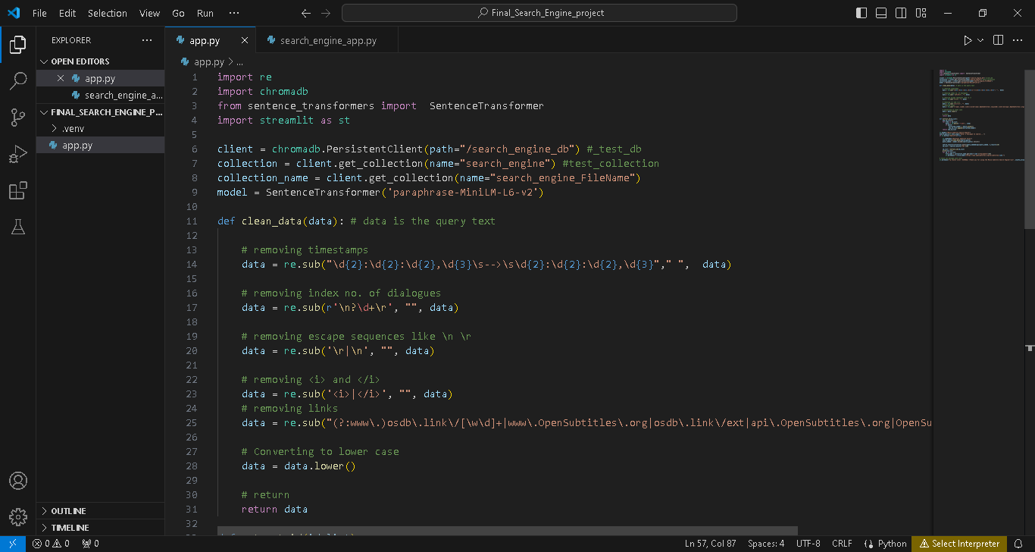
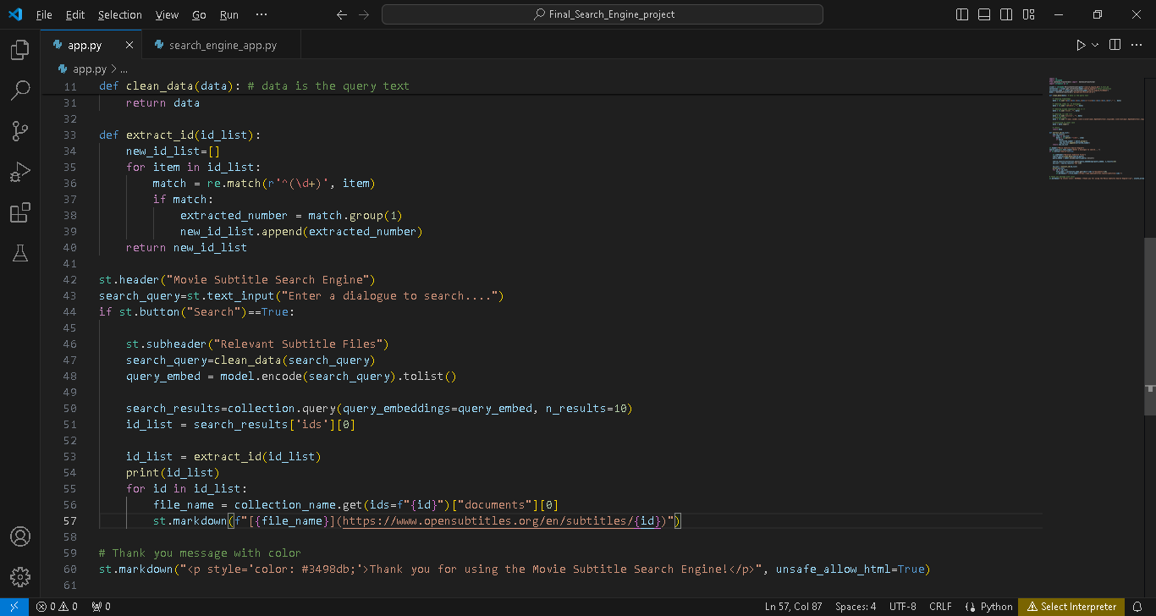
Code for the search Engine (app.py)

Slide 5
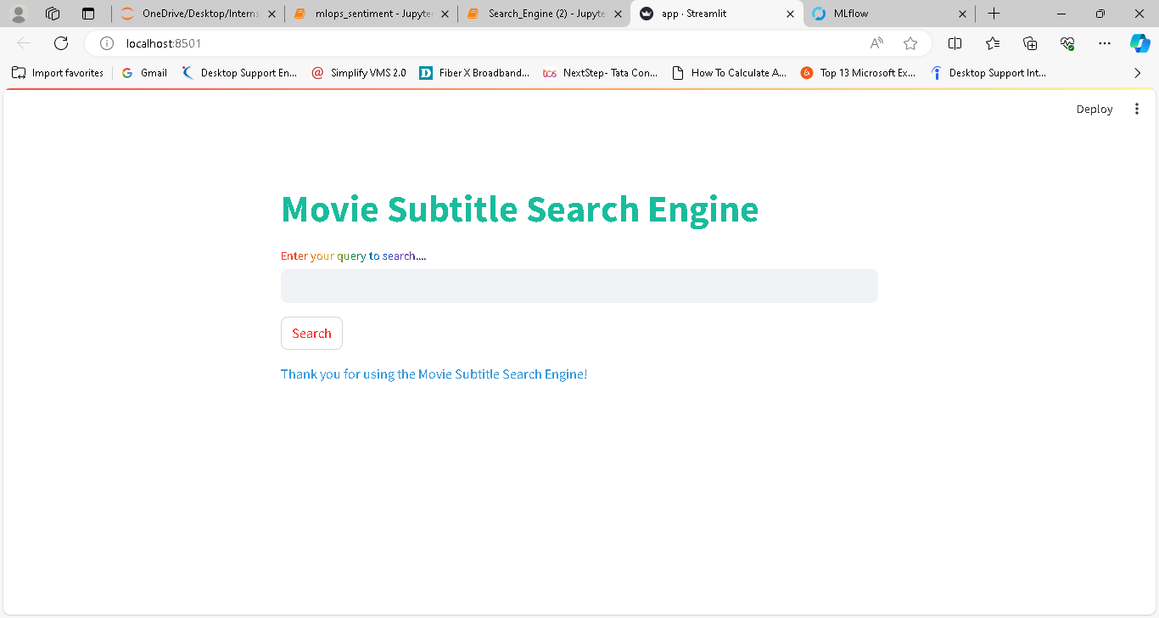
Output of the code (app.py)

Slide 6
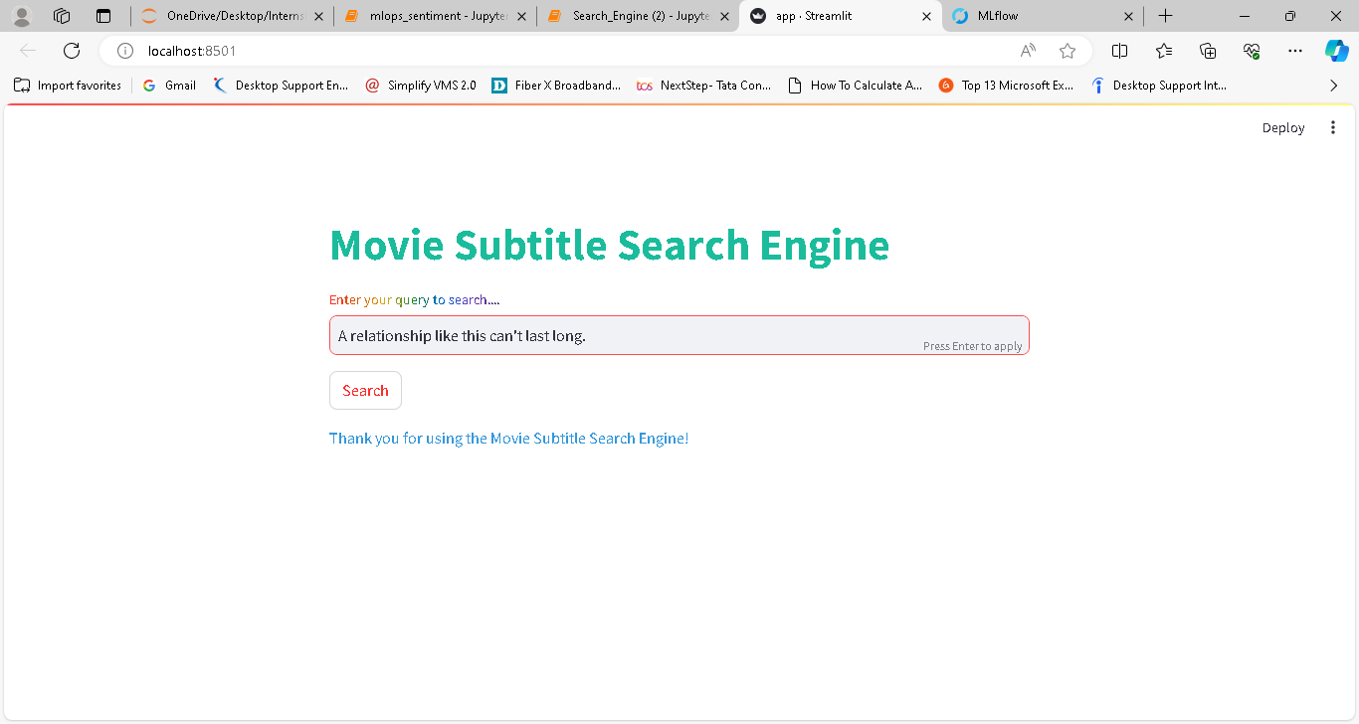
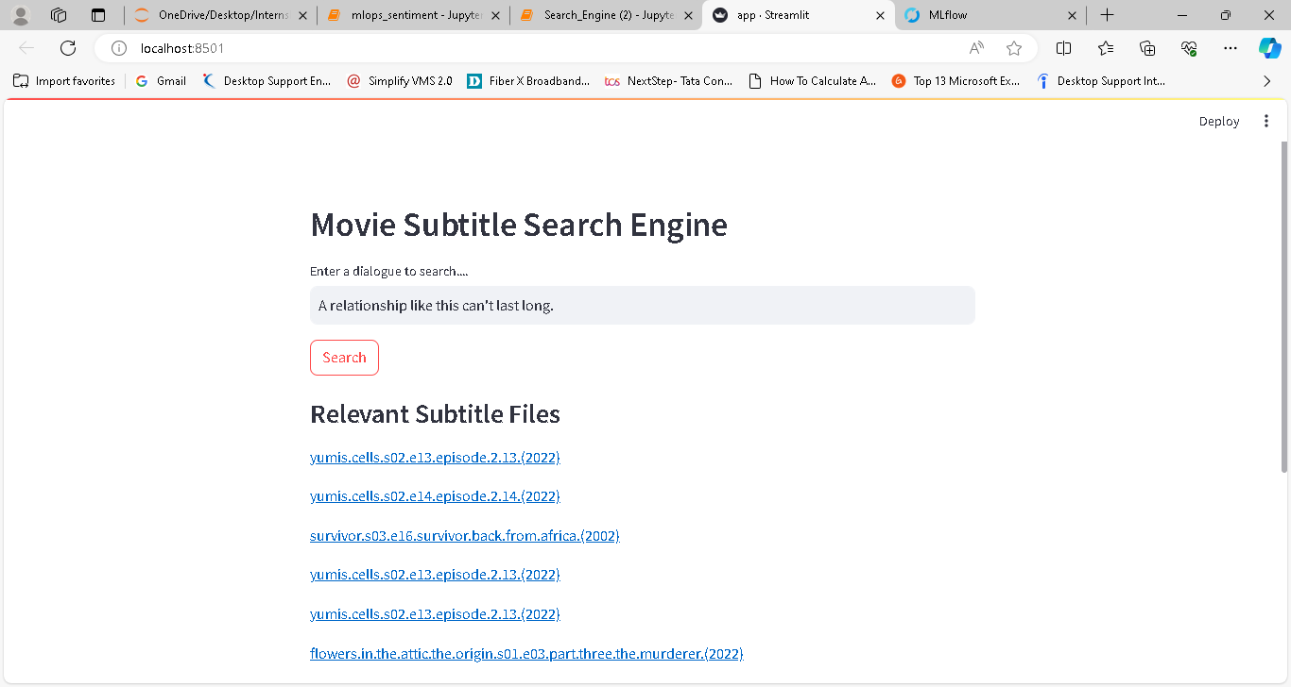
Question
Answer

Slide 7
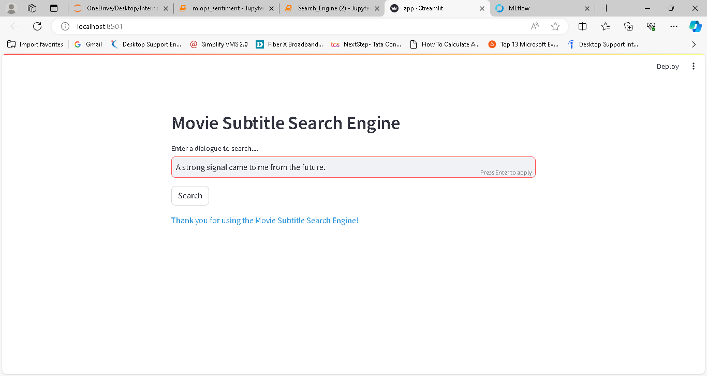
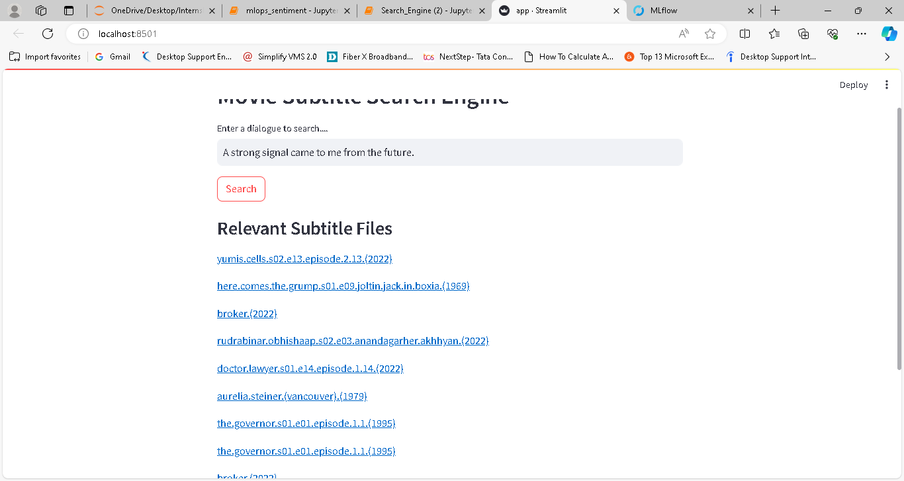
Question
Answer

Slide 8


